Slide 1
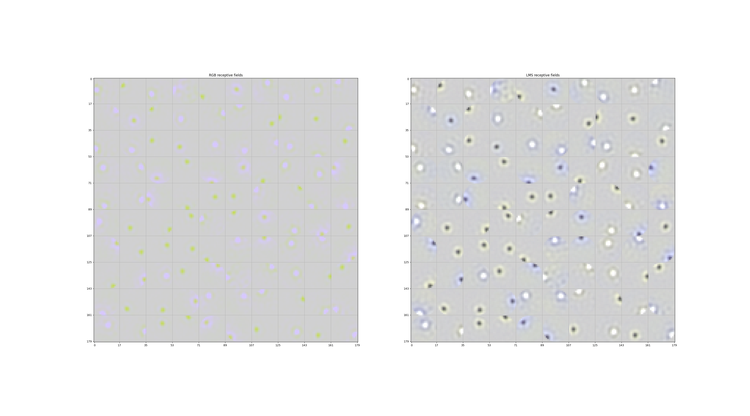
Receptive fields without PCA pre-processing

Slide 2
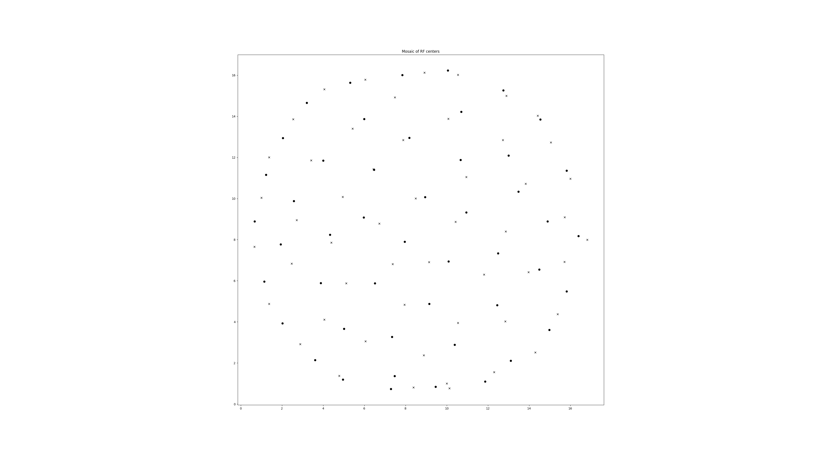
Mosaics no PCA

Slide 3
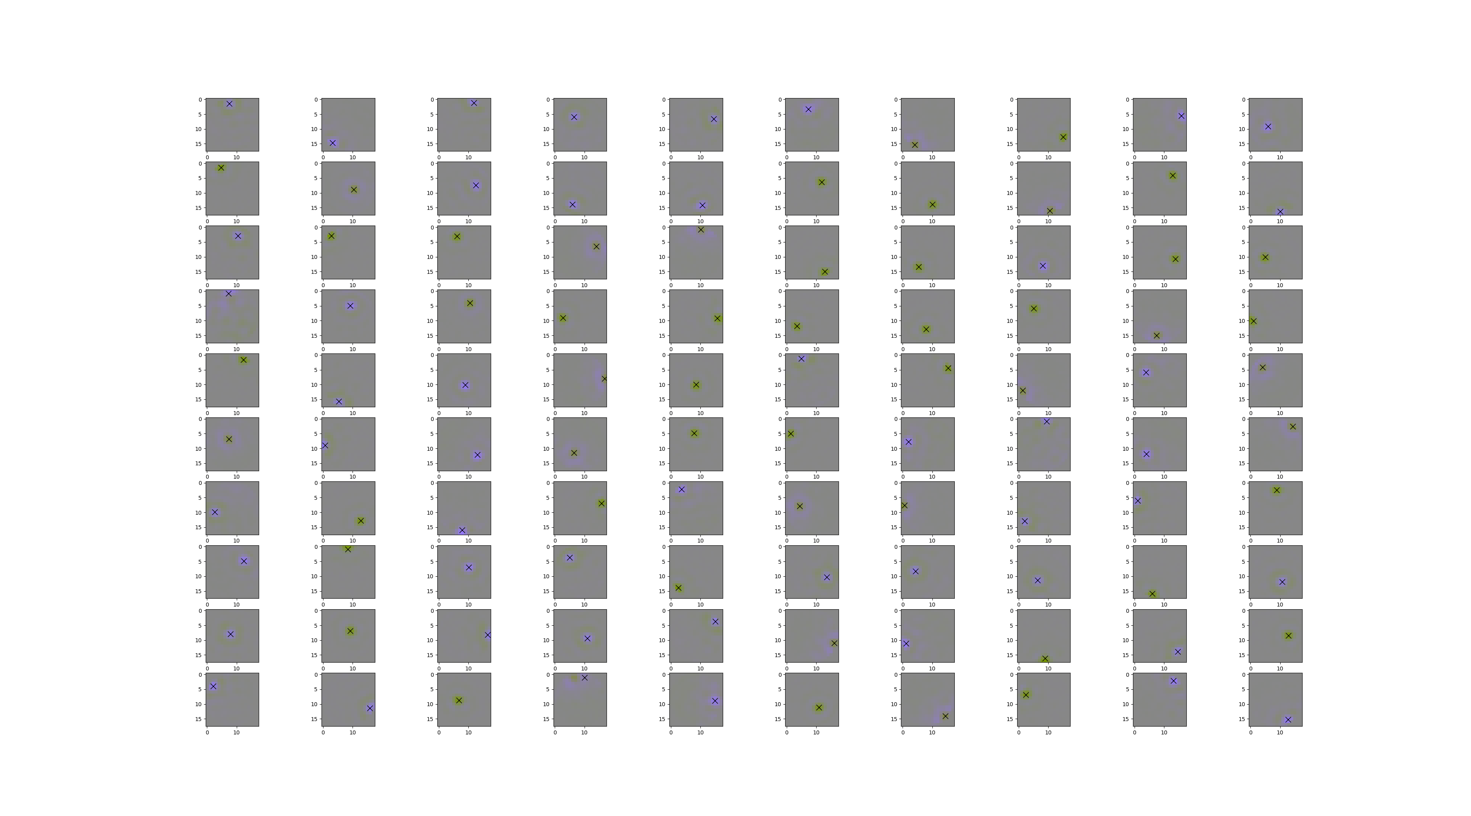
Check that centers are correct

Slide 4
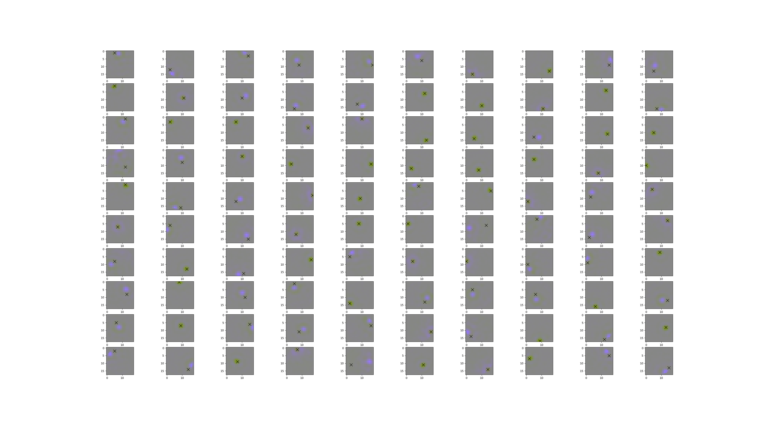
Have to be wary of normalization

Slide 5
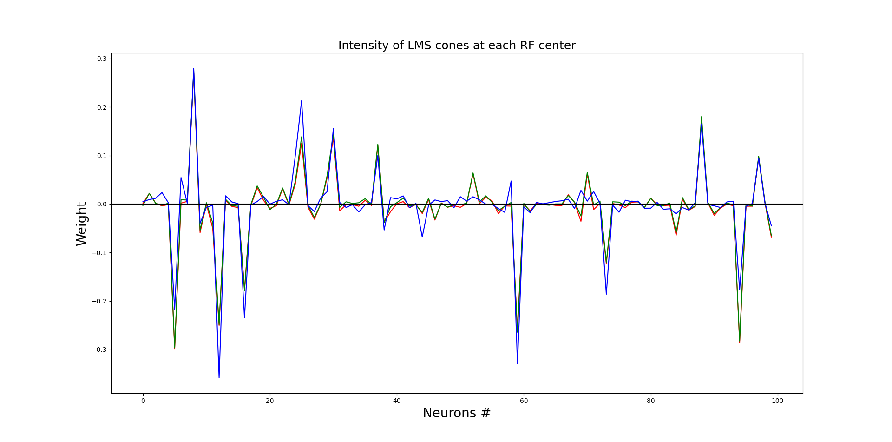

Slide 6
